Slide 1


Our Mission:
To provide technical assistance and education to all Scott County partners, citizens and government entities in order to improve water quality and stormwater management.
Cassie Druhl, Coordinator
info@partnersofscottcountywatersheds.org
Web: partnersofscottcountywatersheds.org
@partnersofscottcountywatersheds

Slide 2
Soil Health/ Cover Crops
More than just soil texture and chemistry.
Mark Schutt
District Conservationist Davenport Field Office
USDA is an equal opportunity provider and employer.

Slide 3
Big Problems in Iowa Agriculture
Erosion
  Iowa has lost 50% topsoil
Organic Matter Loss
  50% loss of soil organic matter
Nutrient Losses – runoff & leaching
Lack of Action on Big Problems
  Short-term outlook
  Easier management – way we have done it
Notes:
50% topsoil loss Risser, J. (1981) A renewed threat of soil erosion: it’s worse than the Dust Bowl. Smithsonian 11: 120–122 124 126–130. 2007 National Resources Inventory (NRI) 5.2 tons/acre/year = 0.035 in
Our soils have lost over 50% of their soil carbon since we began farming Paustian 1997

Slide 4
Major concerns with crop production:
Timely field operations (planting, spraying, harvesting)
Moisture management (too much/too little)
Good root growth and development
Nutrition (optimal nutrient supply)
Plant health
Weed control
Maximize Yield verses Maximizing Economic Return

Slide 5
We can’t control the weather – the dominant variable in farming
We CAN influence how the land responds to weather
Management strongly impacts soil structure which in turn impacts:
water infiltration\percolation\retention
carrying capacity\compaction resistance
root growth
nutrient retention\availability
habitat for living organisms

Slide 6
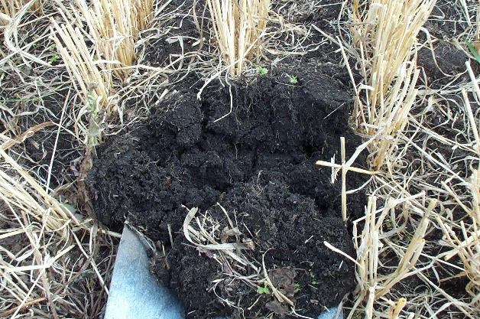
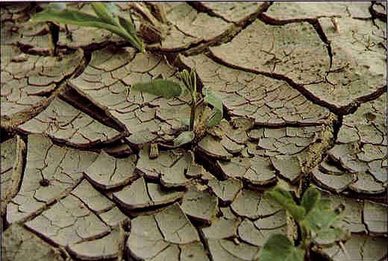
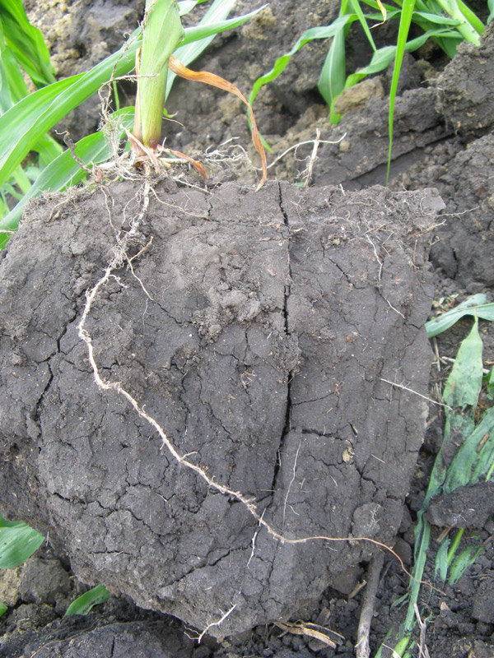
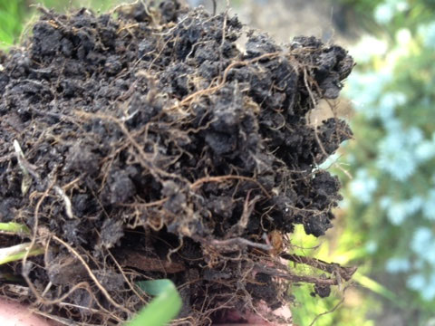
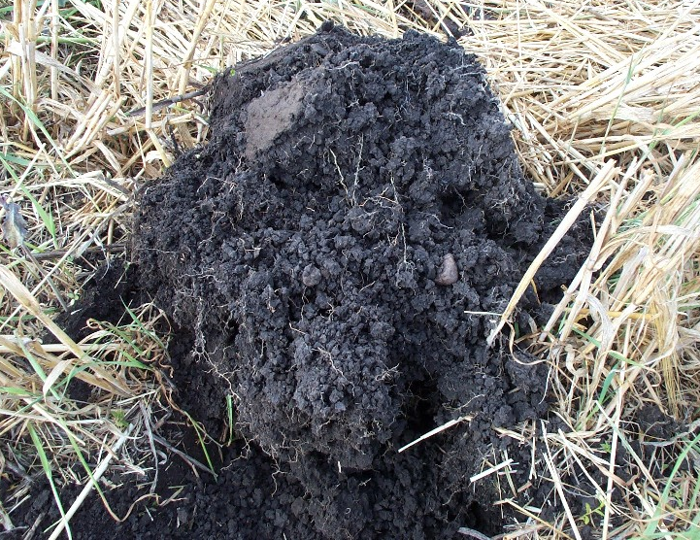
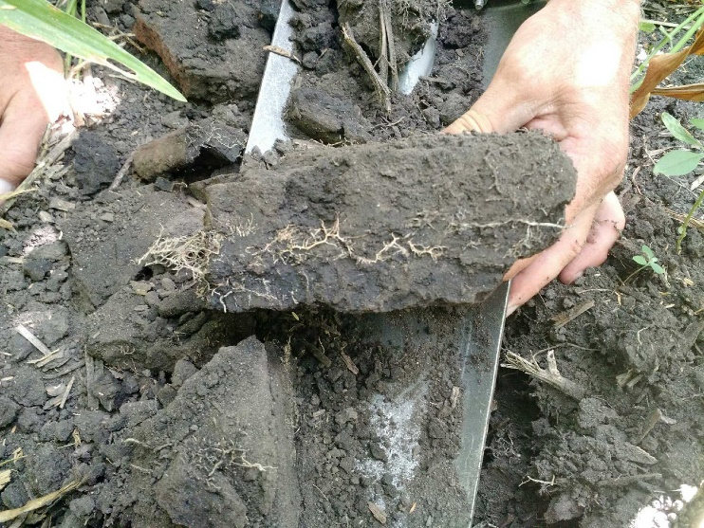
Poor Soil Structure Good
Aggregation is created by biotic glues between the soil particles (sand, silt, clay). Glomalin is excreted by AMF (Arbuscular Mycorrhiza Fungi)

Slide 7
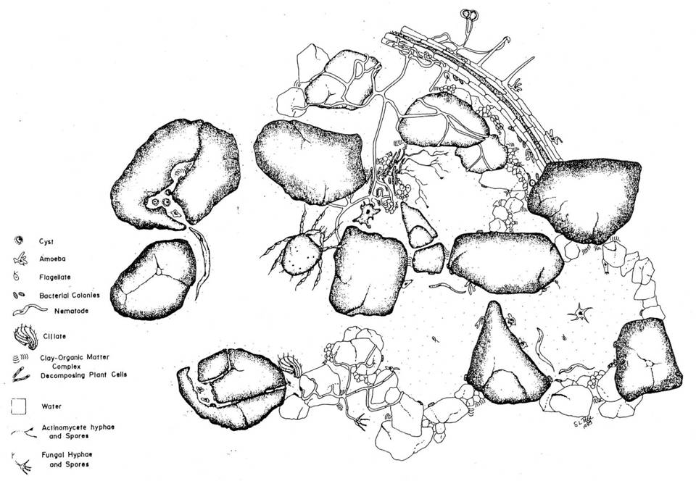
SOIL IS HABITAT
Plant root
Soil particle
Water
Notes:
View the soil as habitat for microorganisms, just as you might view forests or fields as habitat for animals. If we want to encourage a diverse and healthy habitat for microorganisms we must provide food, nutrients, proper aeration, pH, water, etc.

Slide 8
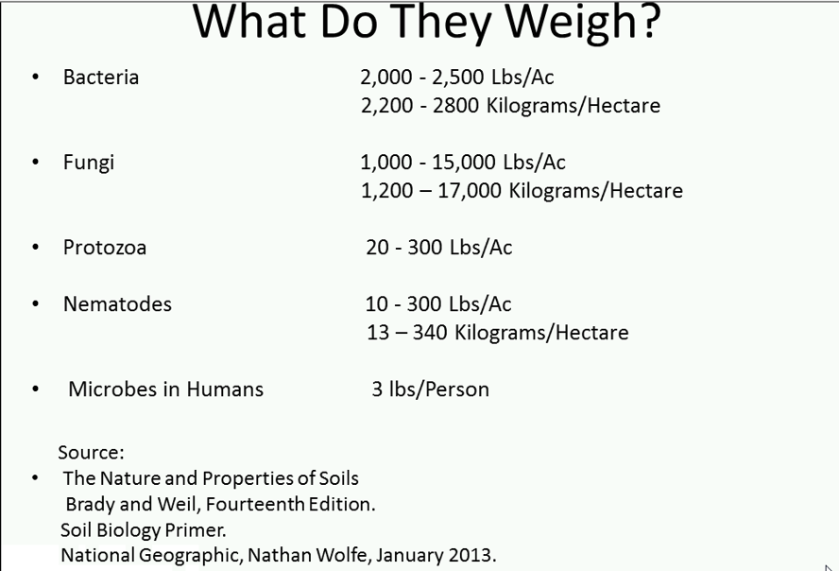

Slide 9
Cornerstones of Soil Health
1. Little or No Soil Disturbance
2. Diverse Crop Rotations and Multi-species
Cover Crop Mixtures
3. Living Roots Growing Most of the Year
4. Year Round Residue on Soil Surface
5. Add livestock to the system

Slide 10
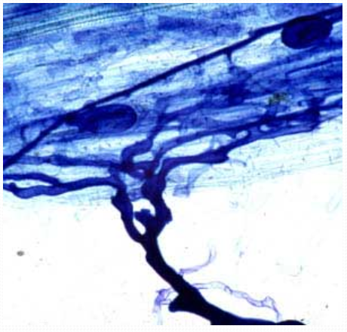
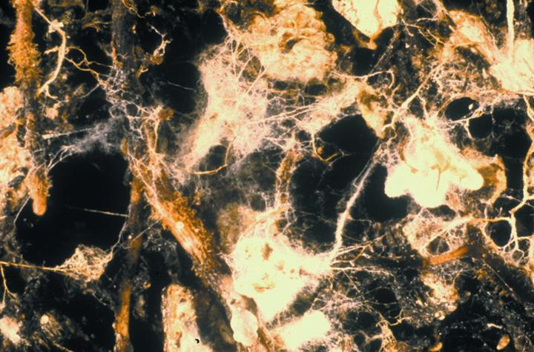
Mycorrhizae - Fungi
Arbuscule Point of interaction between plant root and Fungi
Fungal hyphae
Tree root
Fungal hyphae
Mycorrhizal structure
Notes:
Photo credit: Randy Molina, Oregon State University, Corvallis.
File name: M4 Fungi LR.jpg, 328K
Mycorrhizae can reduce pathogens in soybeans except (D-6o soybean variety)
Protect cotton from Verticillium wilt when cotton is low in phosphorous
Reduce “take-all” disease in wheat

Slide 11
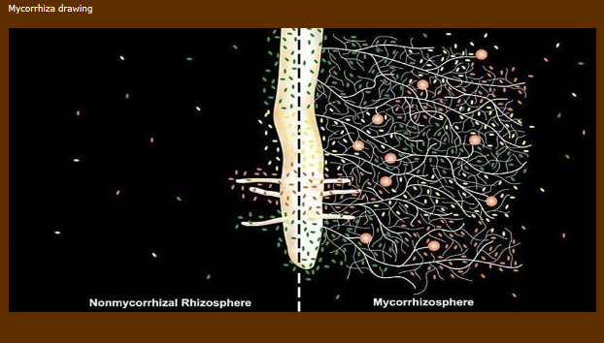
www.mycorrhiza.eu/e/home-e
No Mycorrhiza Mycorrhiza

Slide 12
Benefits of Using Cover Crops
Reduced erosion
Reduced nitrate leaching
Reduced phosphorus losses
Increased soil organic matter
Improved weed control
Support and maintain soil organisms
Improve soil structure – especially no-till
Grazing and forage potential
Recycling manure nutrients

Slide 13

Corn and Soybeans have a 7 Month “BROWN” Gap
Soil productivity is lost during the “BROWN” gap because there are no “GREEN” plants to protect soil and recycle nutrients.
Corn or Soybean Crop at Maturity approx. Oct. 1
Corn or Soybean Crop at Emergence approx. May 1
Phosphorus
Nitrogen
Soil OM
Topsoil
Winter Cover Crops “Catch” Losses
Cover Crops Fill the “BROWN” Gap with “GREEN” Plants
Notes:
One of the reasons agricultural fields with annual crops lose soil, water, N, P, C, and topsoil is because there are no living plants for extended periods. Natural systems have some plants growing most of the time that the ground is not frozen. Living plants also help to maintain soil organisms, like worms, fungi, and bacteria.

Slide 14
Rye Cover Crop Effect on Soil Quality in a Corn Silage System after 10 years
A rye cover crop “increased” total soil organic matter (SOM) in the top 4 inches from 4.8% to 5.3% or ½% change in SOM
Very rough estimates would say a ½% change in SOM would result in an additional ½ inch of water and 8-10 lbs/ac of mineralized soil N.

Slide 15
Value of Soil Organic Matter
Assumptions: 2,000,000 pounds soil in top 6 inches
1% organic matter = 20,000#
Nutrients
Nitrogen: 1000# * $0.44/#N = $440
Phosphorous: 100# * $0.43/#P = $ 43
Potassium: 100# * $0.41/#K = $ 41
Sulfur: 100# * $0.50/#S = $ 50
Carbon: 10,000# or 5 ton * $2/Ton = $ 10
Value of 1% SOM Nutrients/Acre = $584
Jim Kinsella/Terry Taylor (2006) Jim Hoorman (2011) ISU Crop Budgets (2014)
Notes:
The value of SOM. There is 2 million pounds of soil in 6 inch slice. So 1% SOM has 20,000 pounds or 10 ton. About 50% of SOM is carbon so 10,000# or 5 ton of carbon exist in every 1% SOM. Associated with that 1% SOM is a 1000 pounds of N, and roughly 100 # each of P, K, and S. The value of 1% SOM at today’s fertilizer prices is roughly $584 for every 1% SOM. So what is the value of 3% SOM? $1,752. How about 6% SOM $3,504. Dark black soils rich in SOM are more valuable than light colored soils with less SOM.
How much SOM can we accumulate in a typical year? Answer is about .1 to .15 SOM which is equal to $58 to $88/A in nutrients. This is a minimum value because SOM also has economic value for other things (water storage, soil structure, microbial food etc.)

Slide 16
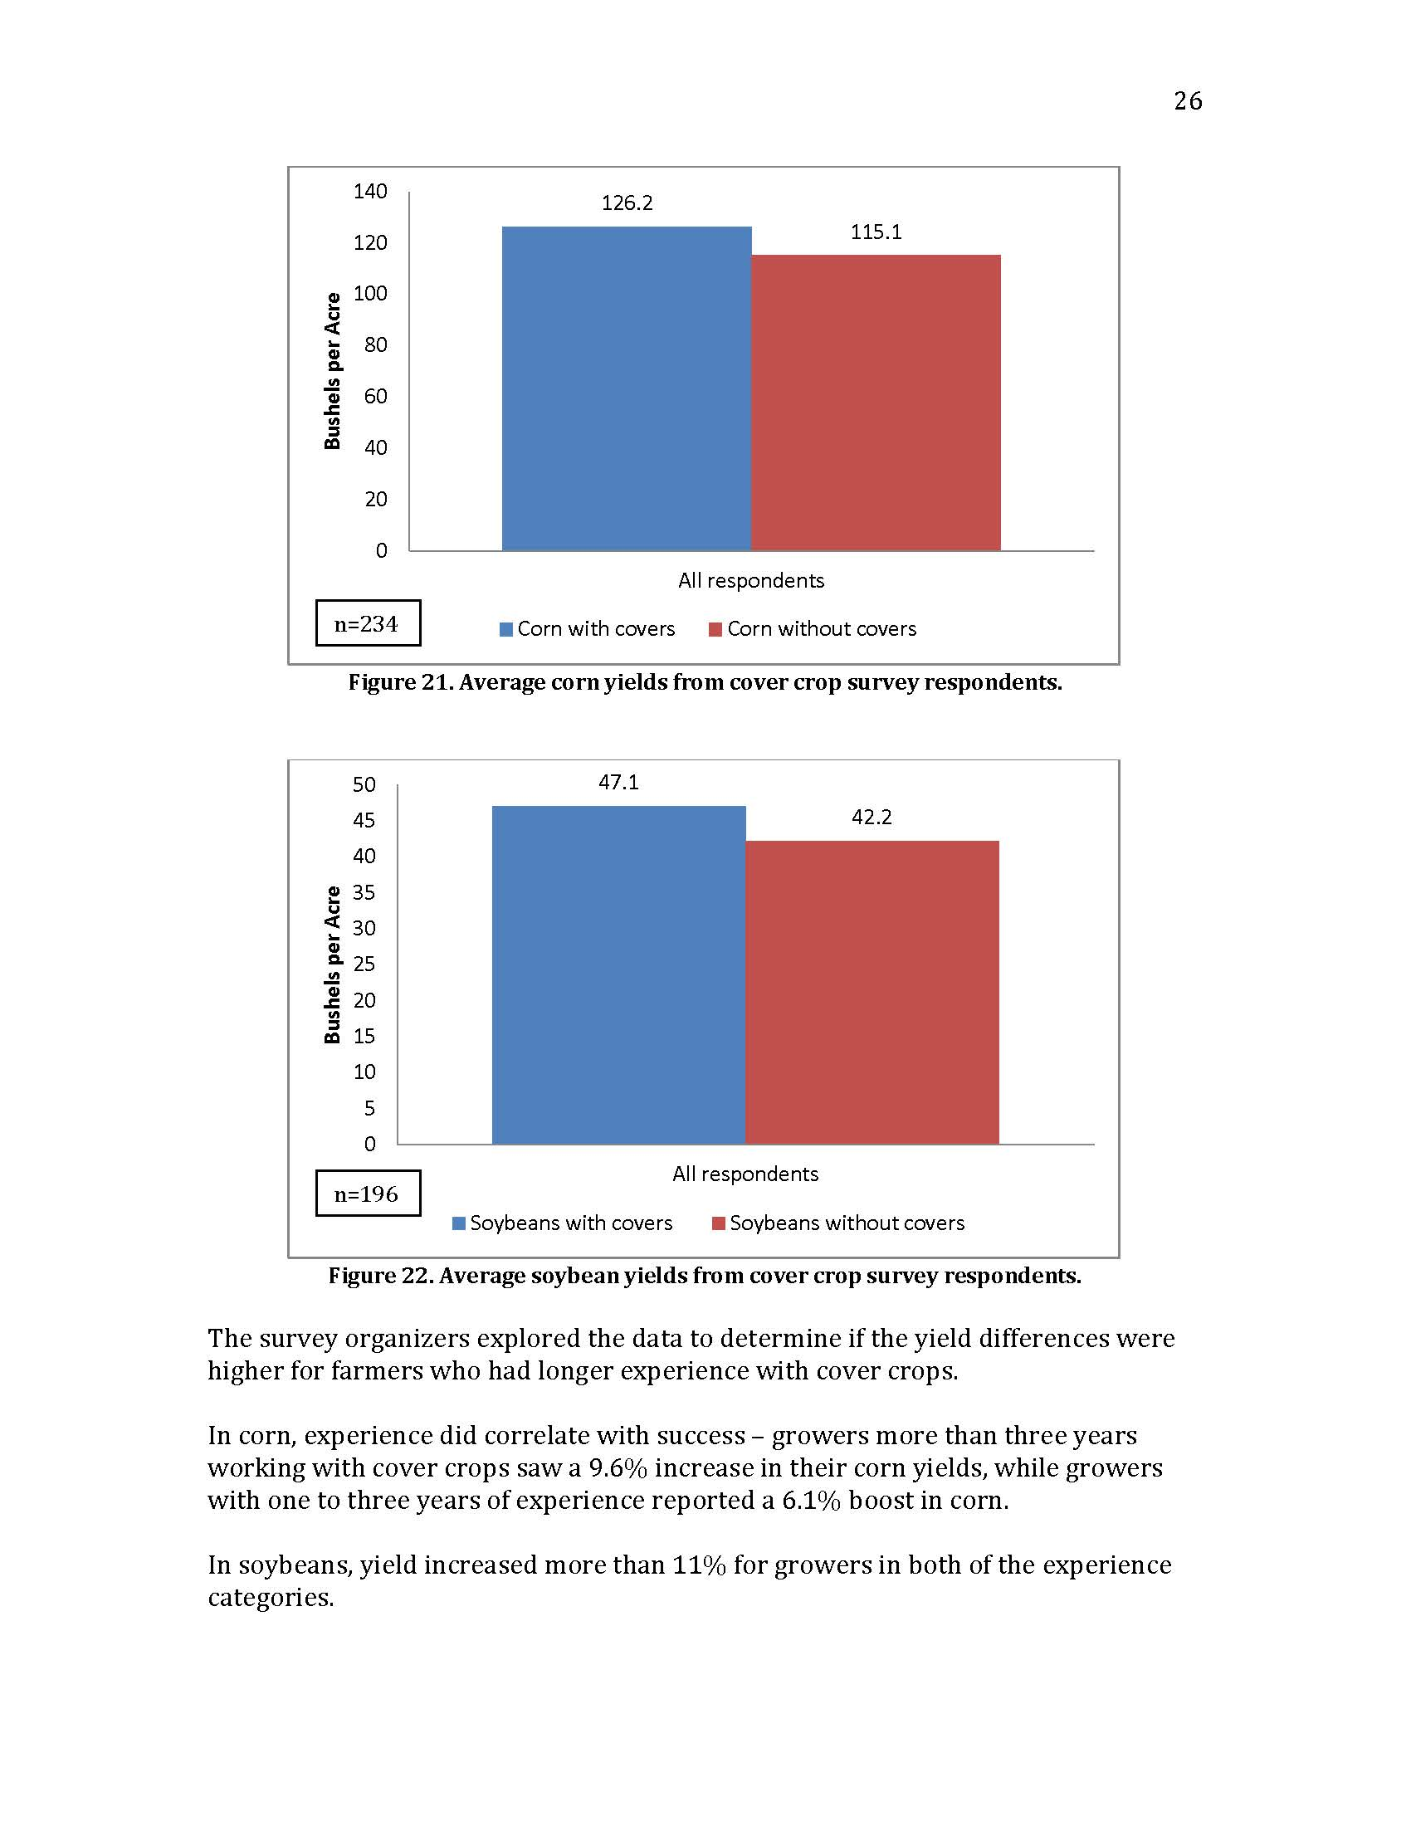
Increased Organic Matter
Increased Water Holding Capacity
A pound of SOM can absorb 18 to 20 lbs. of water.
1% SOM = 20 to 25,000 gal. more water available
Drought States Crop Yields for 2012
Source: SARE/CTIC Survey 2013
Notes:
Value of yields with vs. without cover crops (2012 prices)
Corn = 11.1 bushels At $6.94/bushel = $77.03
Soybeans = 4.9 bushels At $14.54/bushel = $71.25

Slide 17
Even where normal rates of fertilizer are used, soil organic matter and rotation
residues are the main source of N taken up by corn.
From Omay, et al. 1998. SSSAJ 62:1596-1603

Slide 18
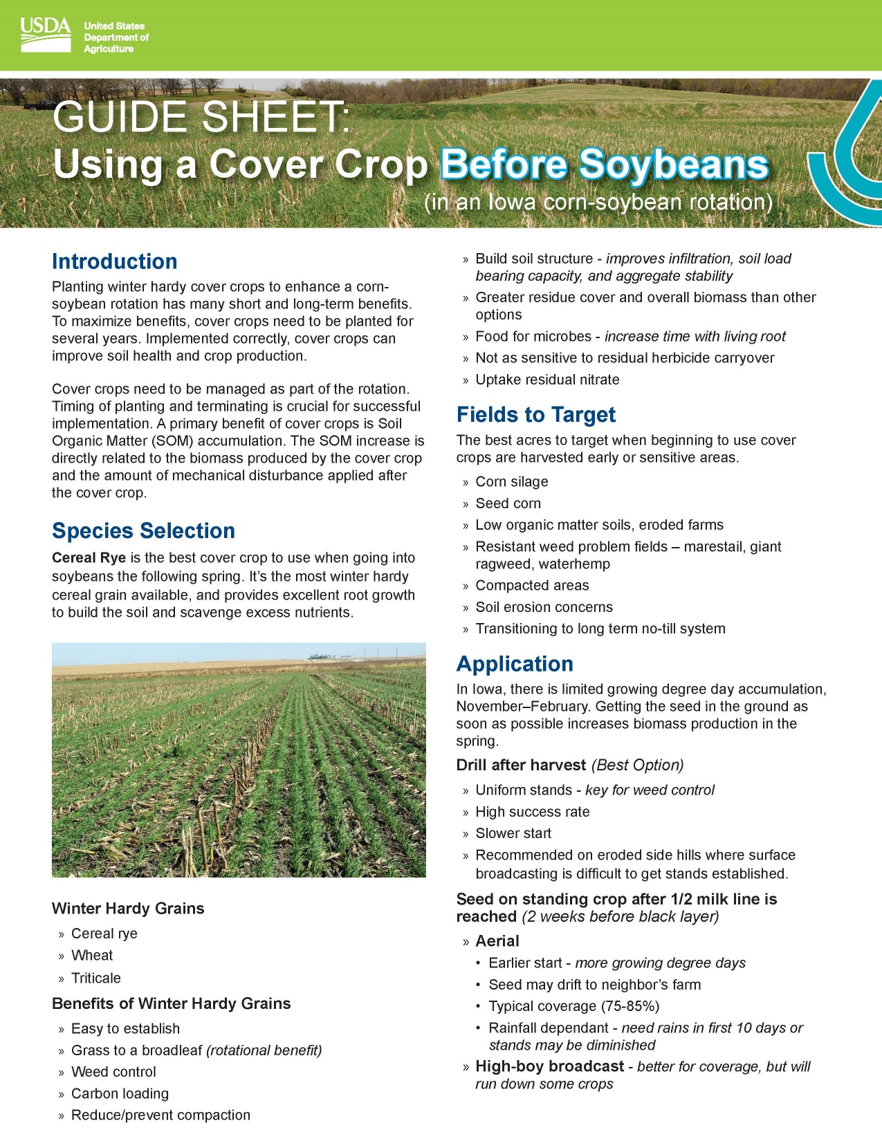

Slide 19
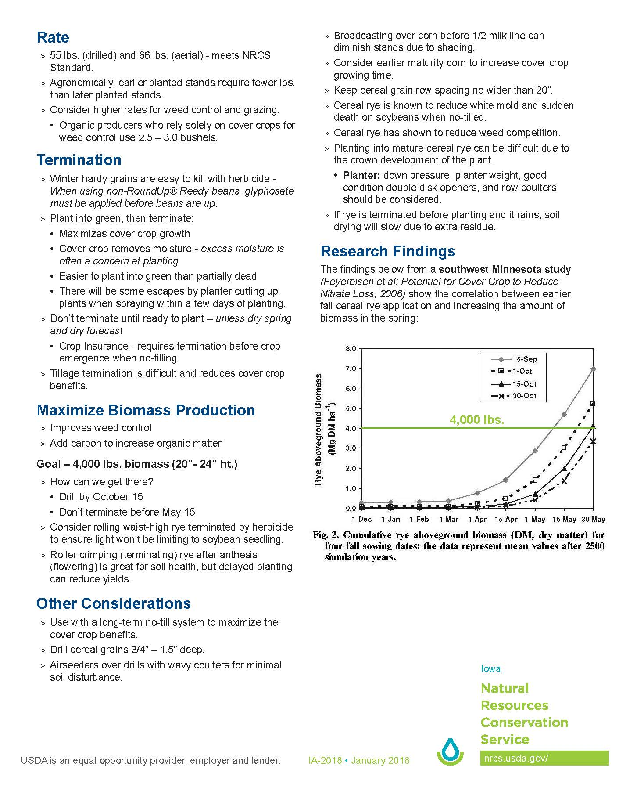

Slide 20
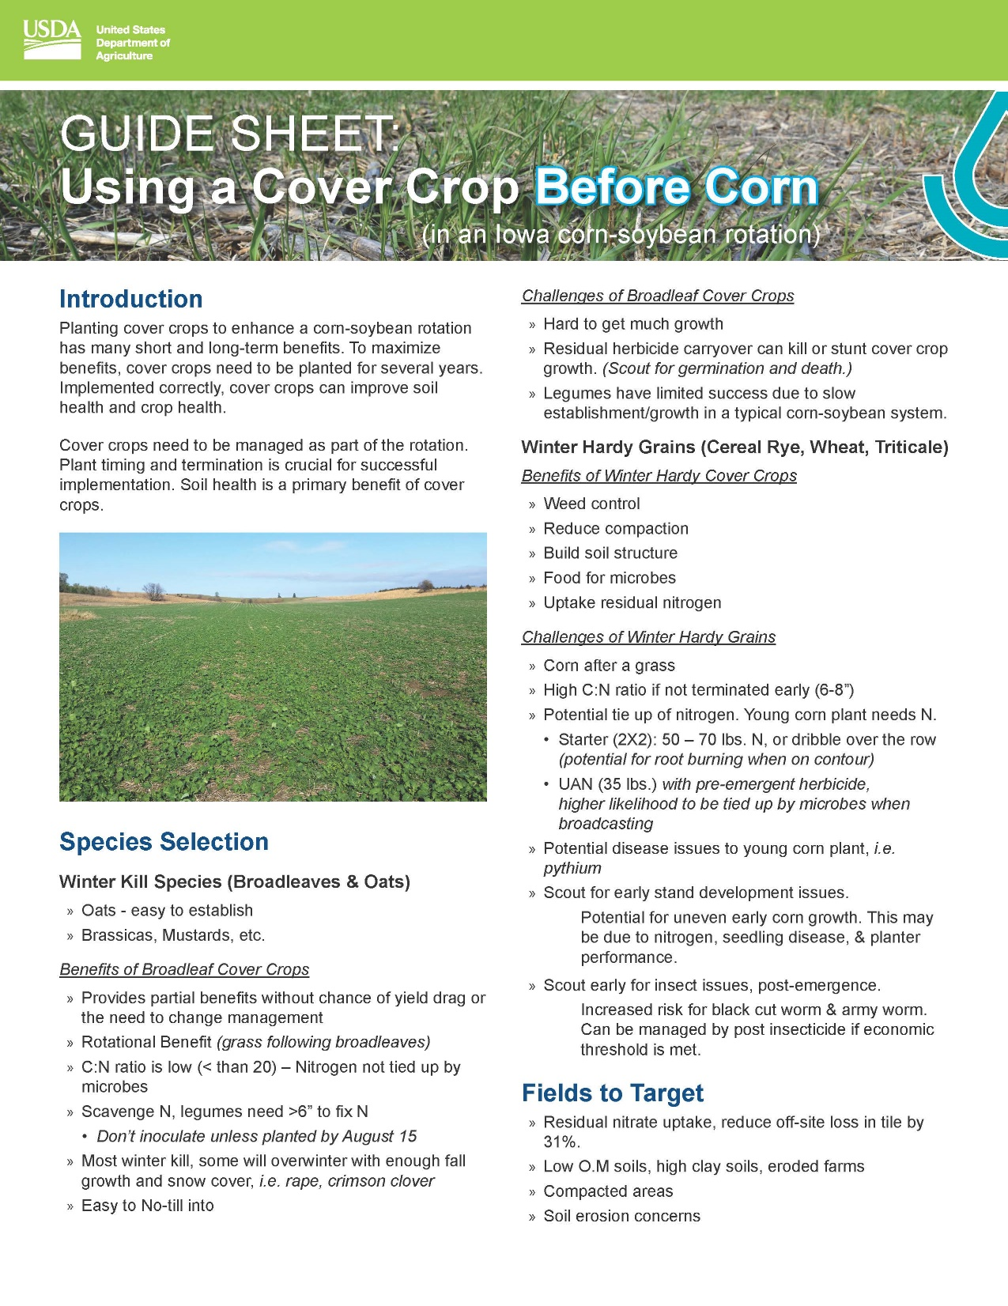

Slide 21
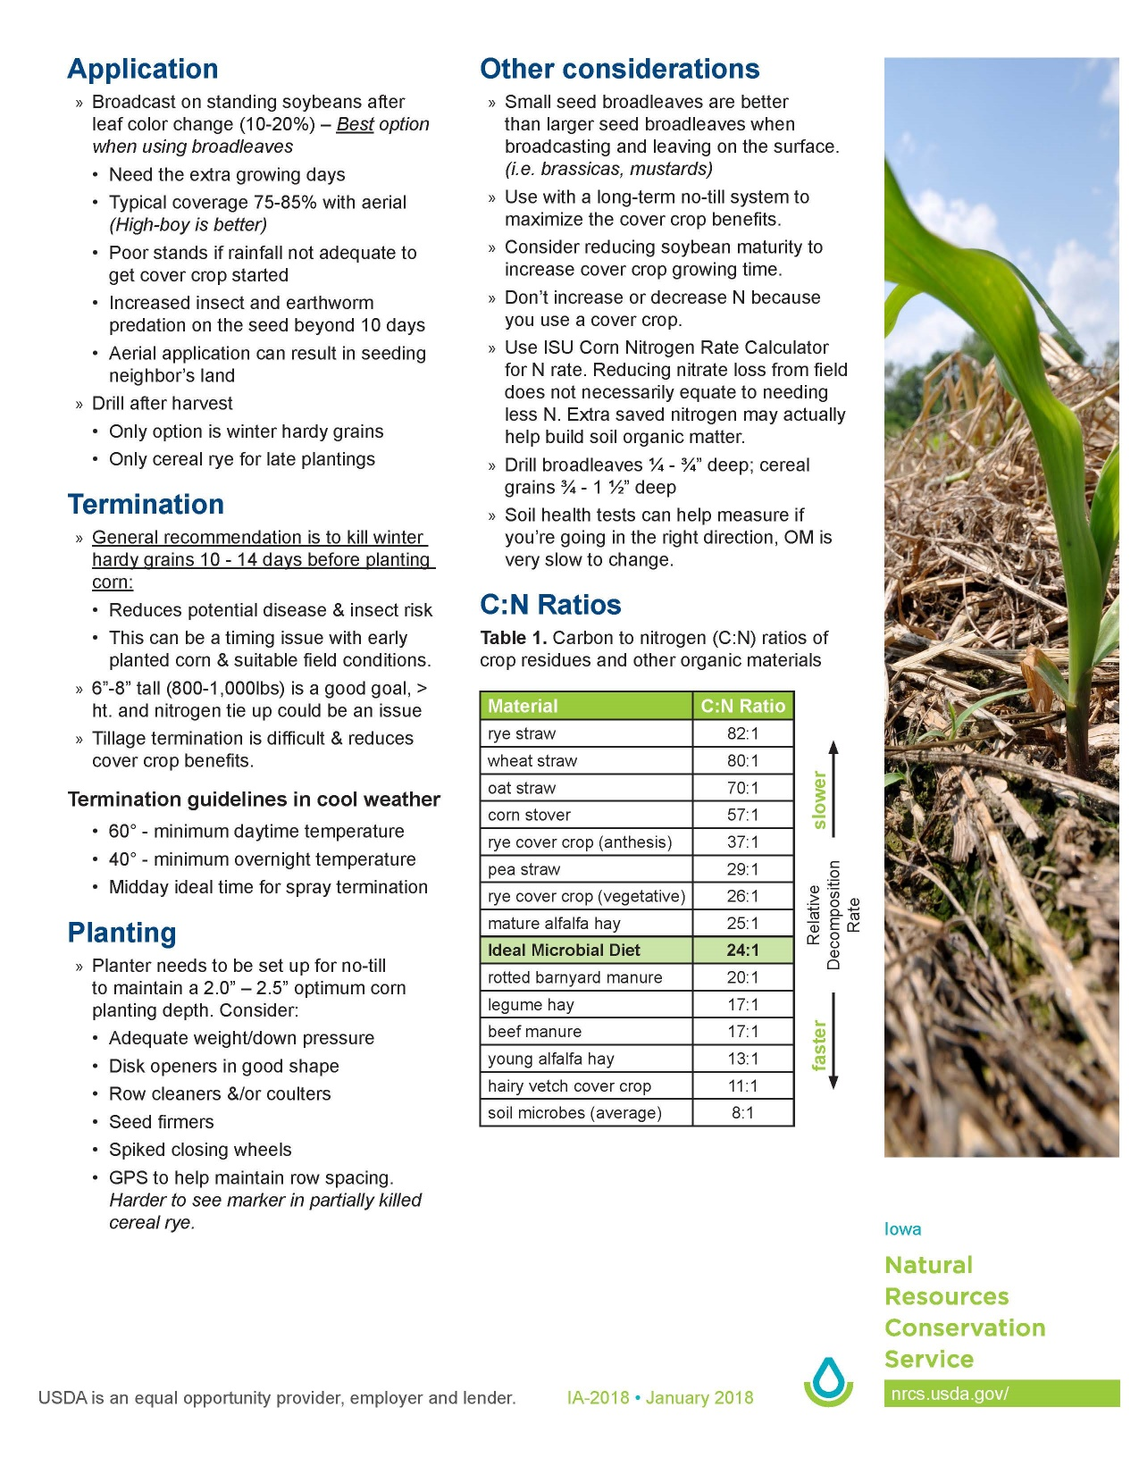

Slide 22
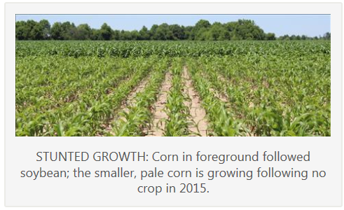


Fallow Syndrome
Missouri saw plenty of stunted corn
acres this growing season. And while
there are no proven recommendations
for alleviating the poor corn growth
following prevented planting acres,
University of Missouri Extension corn
specialist Greg Luce says that prevention
is the key when it comes to these acres.
Prevention is centered on keeping something growing as much as possible.

Slide 23
When soil temp reaches. . .
140° F
Soil bacteria die
130° F
100% moisture lost through evaporation & transpiration
15% moisture is used for growth
85% moisture lost through evaporation & transpiration
100° F
70° F
100% moisture is used for growth
J.J. Mc Entre, USDA SCS, Kerrville, TX, 1956

Slide 24
USDA EQUAL OPPORTUNITY STATEMENT
The U.S. Department of Agriculture (USDA) prohibits discrimation in all its programs and activities on the basis of race, color, national origin, age, disability, and where applicable, sex, marital status, familial status, parental status, religion, sexual orientation, genetic information, political beliefs, reprisal, or because all or a part of an individual’s income is derived from any public assistance program. (Not all prohibited bases apply to all programs.) Persons with disabilities who require alternative means for communication of program information (Braille
large print, audiotape, etc.) should contact USDA’s TARGET Center at 202-720-2600 (voice and TDD).
To file a complaint of discrimination, write USDA, Director, Office of Civil Rights, 1400 Independence Avenue, SW, Washington, DC 20250-9410 or call (800) 795-3272 (voice) or (202) 720-6382 (TDD). USDA is an equal opportunity provider and employer.

Slide 25
Soil Health and Cover crops
Questions?
Contact information: Mark Schutt – 8370 Hillandale Rd Davenport Iowa
563-391-1403
mark.schutt@usda.gov

