Slide 1
NRCS PRACTICES TO REDUCE SOIL EROSION

Slide 2
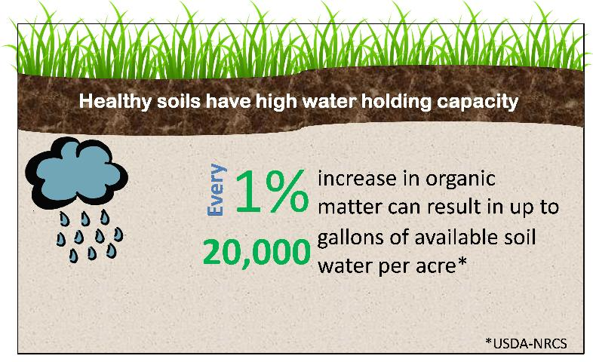
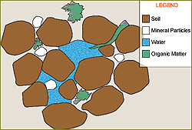
PATHWAYS TO REDUCE SOIL EROSION
Field scale management changes
Increase water storage in the soil
Examples
Cover crops
No-Till
Notes:
20,000 ga/acre = additional storage for ¾” rainfall

Slide 3
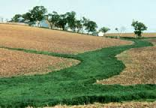
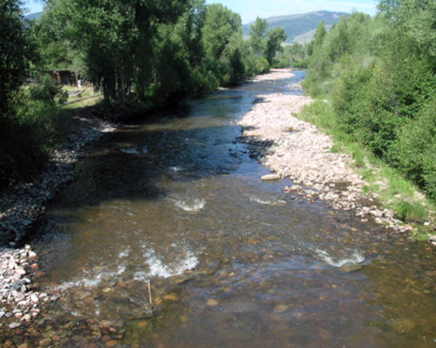
PATHWAYS TO REDUCE SOIL EROSION
Establish stable areas for water to move through
Construct stabilized waterways
Grassed waterway
Improve stream bank stability
Vegetated buffers
Riparian tree planting
Streambank stabilization projects- $$
Grassed Waterway
Stabilized Stream Coridor

Slide 4
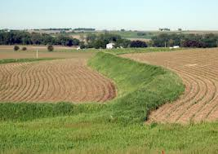
PATHWAYS TO REDUCE SOIL EROSION
Create water holding structures
Short term structures hold water back and release it over a longer duration (24-48 hours)
Slowing water velocity reduces the sediment it can carry
Urban-
water detention basin
Agricultural
Water & Sediment control basin
Terraces
Terrace
Water Level during rainfall
Terrace
Trapped sediment
Water Inlet

Slide 5
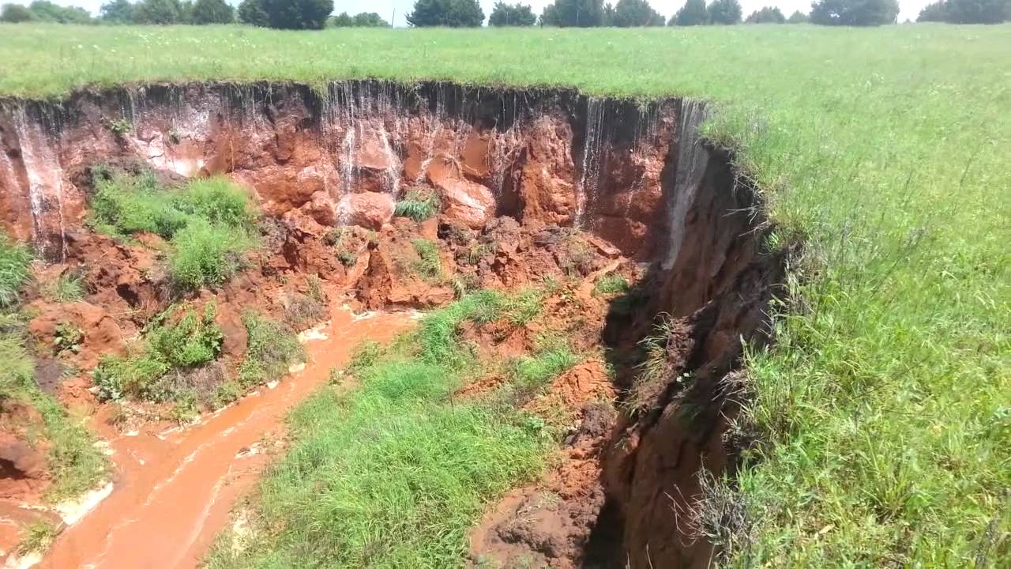
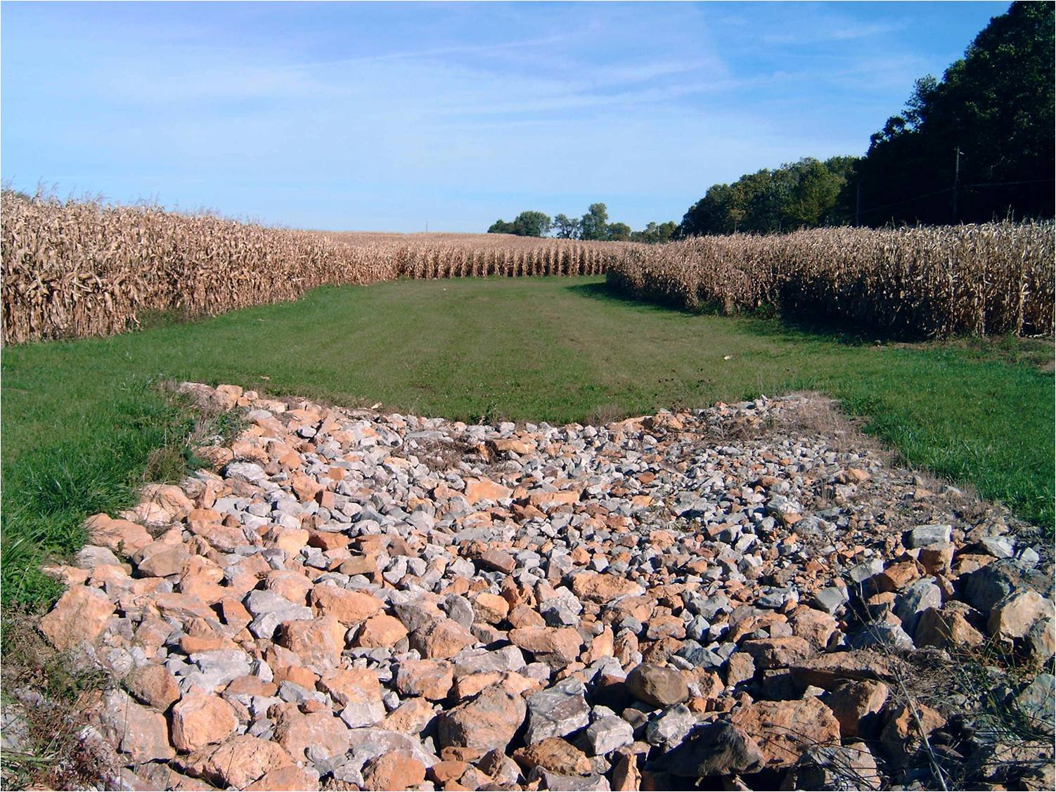
PATHWAYS TO REDUCE SOIL EROSION
Construct Grade Stabilization Structures
Water impounding grade stabilization structures back water over the unstable grade
Farm Ponds
Structures can be built to armor the area of erosion
Rock Chutes
Fabric lined chutes
Headcut formed from water
moving over an unstable grade
Farm Pond
Rock Chute

Slide 6
PROCESS FOR SELECTING EROSION CONTROL PRACTICES
Determine the underlying cause of the erosion
Why has the erosion taken place?
What type of erosion is occurring
Understand the Landowner’s goals and management system
Equipment sizes
Management preferences

Slide 7
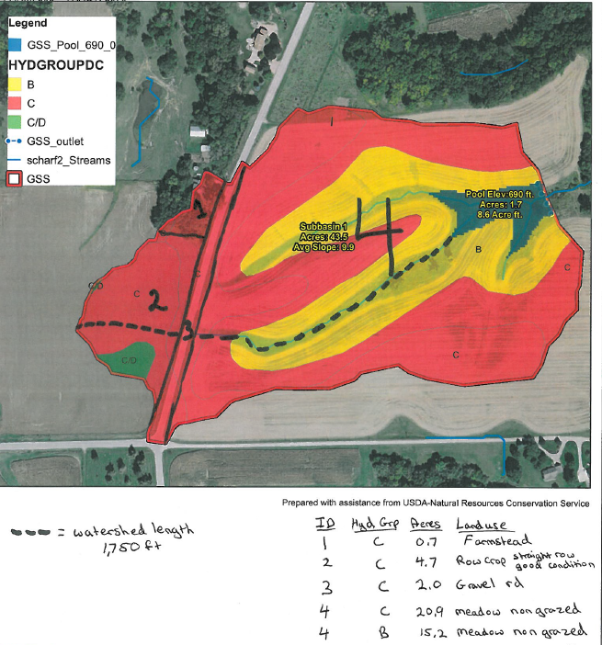
PROCESS FOR DESIGNING EROSION CONTROL PRACTICES
Landscape factors in structure design
Watershed length and slope
Soil type
Land use/ management
Sediment loss
Environmental factors in structure design
Rainfall amount
Rainfall duration
Most designs are based on a 4.5 inch rainfall event over 24 hours

Slide 8
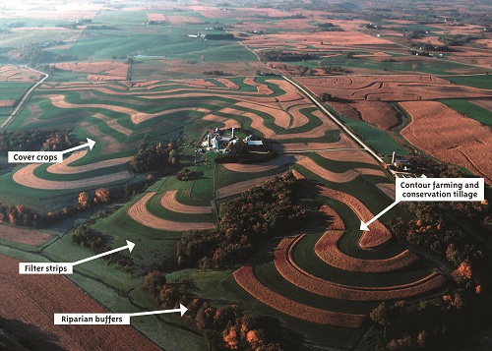
Questions

